Slide 1
Docker Essentials Masterclass
Mastering Containers from Basics to Best Practices
Aliaksandr Kastseryn
DevOps Engineer

Slide 2


Agenda
Containers vs Virtual Machines.
Introduction to Docker.
Core Docker Concepts.
Best Practices and Security.
Hands-on Practice.
Introduction to Docker Compose.
Q&A.

Slide 3
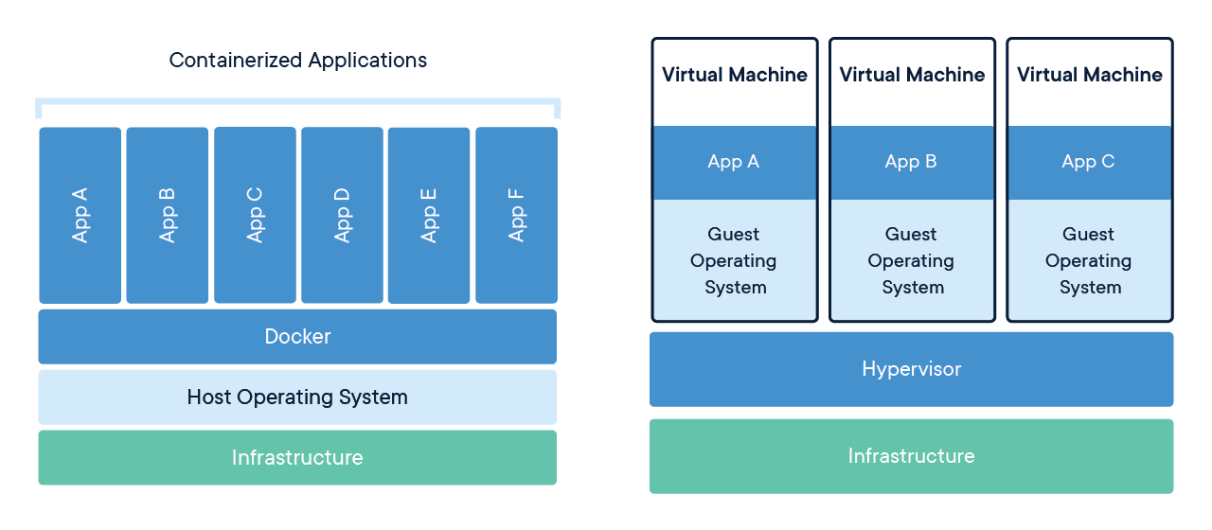
Introduction to Containerization
What is Containerization?
A method to package applications and their dependencies into portable containers.
Containerization vs. Virtualization:
Virtualization: Uses VMs with dedicated OS instances (e.g., multiple VMs on one server).
Containerization: Shares the host OS kernel for lightweight, isolated environments (e.g., multiple containers on one server).
Key Differences:
Faster startup times.
Smaller resource footprint.
Ideal for microservices.

Slide 4
Linux Containerization Tools: Namespaces
What are Namespaces?
Provide isolation for system resources such as processes, networks, and IPC.
Types of Namespaces:
PID: Isolates process IDs.
Network: Creates isolated network environments.
Mount: Controls filesystem mount points.
IPC: Isolates interprocess communication (e.g., shared memory).
UTS: Isolates hostname and domain name.
User: Isolates user and group IDs for security.
Cgroup: Isolates and manages control groups.
Time: Isolates system clock for different time settings.

Slide 5
Linux Containerization Tools: cgroups
What are cgroups?
Control Groups manage and limit system resources for processes.
Resource Management:
CPU: Limits and prioritizes CPU usage.
Memory: Controls memory usage, including swapping.
Disk I/O: Regulates disk input/output.
Network: Controls network bandwidth usage.

Slide 6
Introduction to Docker
Key Features of Docker: Docker utilizes the capabilities of the host operating system kernel to run containerized workloads. Key characteristics include:
Single Responsibility Principle: Containers are designed to handle one task effectively.
Self-contained: Each container is independent and includes everything needed to run.
Standardized Build and Run Process: Unified methods for creating and managing containers.
Lightweight Images: Supports minimalistic, container-friendly images.
Ephemeral Nature: Containers are temporary and designed to be easily replaced or recreated.

Slide 7
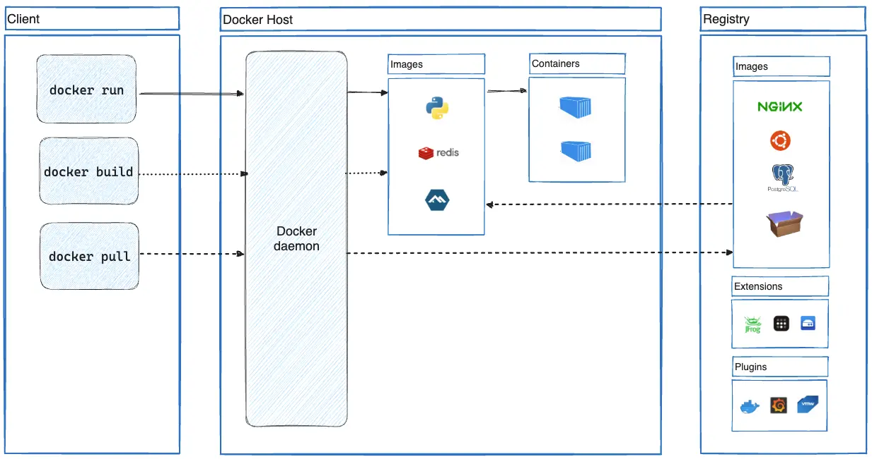
Docker Architecture Overview
What is Docker? Docker is a containerization software providing a client-server solution. It consists of three main components:
Server Component (dockerd): A daemon that handles the core Docker functionalities.
API Interface (Docker API): Allows interaction with the Docker daemon programmatically.
Command-line Interface (Docker CLI): A tool to interact with the Docker environment via commands.
Four Key Entities in Docker:
Dockerfile
Docker Image
Docker Registry
Docker Container

Slide 8
Core Docker Entities: Daemon and CLI
Docker Daemon: The component providing core Docker functionality.
Acts as the server-side of Docker.
Interacts via the Docker API.
Downloads and builds Docker images.
Runs containers.
Manages networking.
Collects and processes logs.
Docker CLI: A client utility to interact with the Docker API.
The client-side tool facilitates communication with the Docker daemon.
Supports both local and remote operations.

Slide 9
Core Docker Entities: Image and Registry
Docker Image: A standardized image for running Docker containers.
A pre-packaged, ready-to-run application in container format.
Created using instructions from a Dockerfile.
Comprised of multiple layers.
Stored in a Docker registry.
Docker Registry: A repository for Docker images.
A storage system for standardized Docker images.
Types of repositories:
Local Repositories: Store Docker images directly on your local machine.
Corporate Repositories: Secure, private storage for organizations, like Harbor.
Remote Repositories: Online repositories for sharing and downloading images, such as Docker Hub.

Slide 10
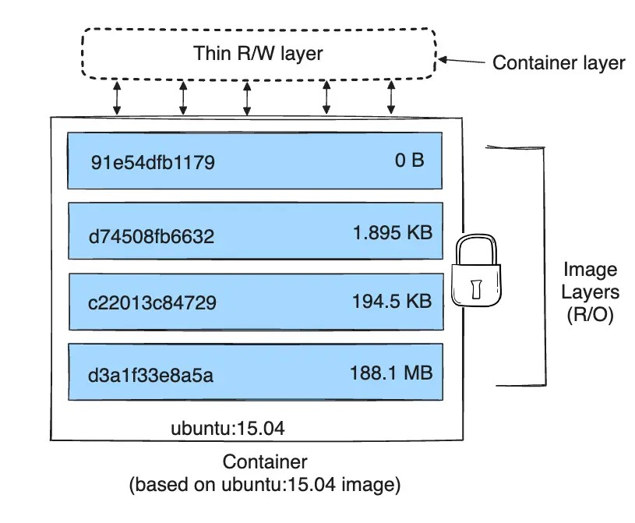
Core Docker Entities: Dockerfile
Dockerfile: A set of instructions for building Docker images.
Contains standardized steps for image creation.
Each instruction in the Dockerfile typically generates a layer in the Docker image.
Instructions like RUN, COPY, and ADD in Dockerfiles contribute to the creation of new layers and impact the image size.
Other Dockerfile instructions create intermediate layers that don't affect the final image size.

Slide 11
Writing a Dockerfile
Core Instructions:
FROM: Base image.
RUN: Execute a command during build.
COPY: Copy files to the container.
ADD: Copy files, directories, or URLs to the container and automatically unpacks archives (e.g., .tar, .tar.gz) if provided.
EXPOSE: Specify a port to expose.
CMD: Default command to run in the container.
ENTRYPOINT: Set a command as the container's entry point.

Slide 12
Docker Commands
Common Commands:
docker run: Run a container.
docker pull: Pull an image from the registry.
docker push: Push an image to the registry.
docker build: Build an image from a Dockerfile.
docker images: List available images.
docker ps: List running containers.
docker exec: Execute commands inside a container.
docker start: Start a stopped container.
docker stop: Stop a running container.
docker rm: Remove a stopped container.

Slide 13
Best Practices for Image Optimization
Optimizing Images:
Use smaller base images
Minimize layers
Remove unnecessary files
Implement multi-stage builds
Utilize .dockerignore
Install only required dependencies
Leverage caching
Clear package caches
Pin package versions

Slide 14
Best Practices for Docker Security
Security Recommendations:
Use trusted, minimal base images
Run containers as non-root users
Limit resource usage
Secure sensitive data
Restrict container-to-host access
Monitor container activity
Keep Docker and images updated

Slide 15
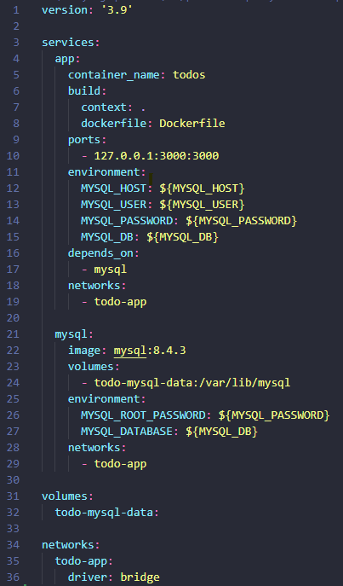
Introduction to Docker Compose
Why Docker Compose?
Simplifies management of multi-container applications.
docker-compose.yml Basics:
Key Directives:
version: Docker Compose file version.
services: Define services (containers).
volumes: Persist data.
networks: Define custom networks.

Slide 16
Docker Compose Commands
Common Commands:
docker-compose up: Start the application.
docker-compose down: Stop and remove containers.
docker-compose logs: View logs from services.

Slide 17
Q&A

